Slide 2
Next-gen Dev. Planning
Projects continue to get more complex.
A schedule alone won’t manage it.
Process needs to encourage diligence and meticulousness.
Plans need to tease out data.
Project Managers need to be interested in doing things better.

Slide 3
Development Plan
More than just a schedule!

Slide 4
Development Plan
Capacity analysis
Resource utilization plan
Feature analysis
Risks list
Milestone deliverables
Asset production list
Schedules – various types
I will focus on a subset of this today.

Slide 5
Capacity Analysis
Capacity plan.
Development capacity estimation.
Development staff budget.

Slide 6
Capacity Plan
# of workers or machine * # of shifts * utilization * efficient.
…or the volume of availability a team has to undertake work in any given period of time.
Simply a measurement of how much time you have.
Don’t let other people tell you otherwise
Not a schedule.
Not a list of tasks either.
A great 1st stage of project planning.
Establishes many initial data points.
Feeds data into other parts of the plan.

Slide 7
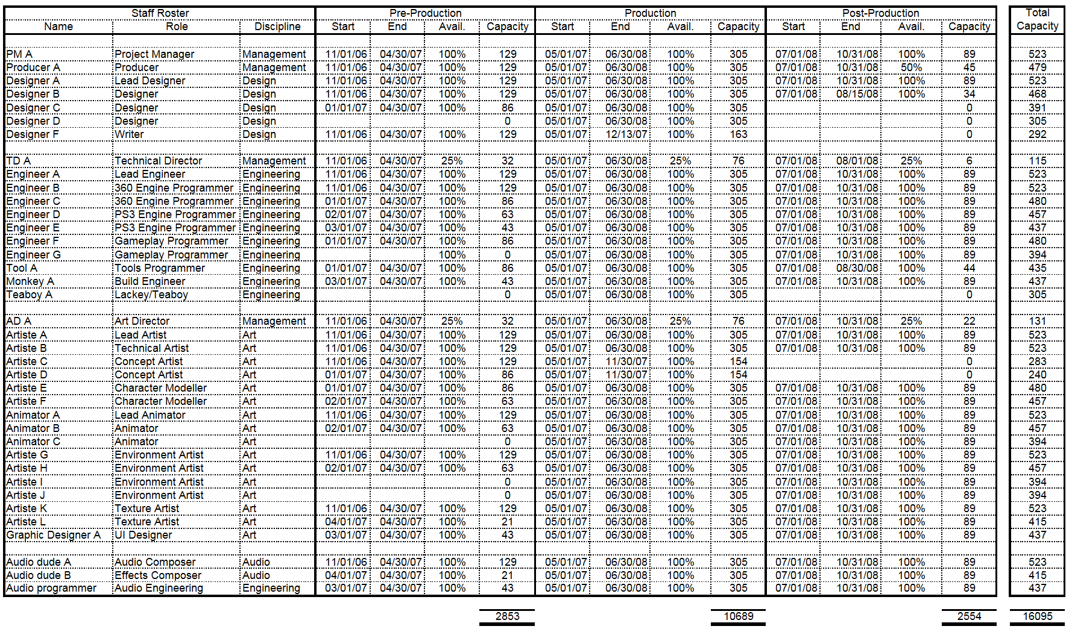
Capacity Plan

Slide 8
Capacity Plan vs Man Months
Man-Month charts do a similar thing.
Typically they don’t consider phases.
Man-month mindset is worth getting away from anyway.
Schedule for the time people have, not what they don’t.
Rarely used for anything other than budget.
Very disappointing to miss other opportunities.

Slide 9
Capacity Plan
First data becomes available
Allows first analysis
Shocking realizations
2 year project is really a 1.3 man year project.
4 month post-production is 89 days.
Motivation for doing this is becoming apparent.
Keeping it real!
EA Spouse won’t blog about you!

Slide 10
Development Capacity
Capacity is made up of:
Productive time
Non-productive time
Unfortunately, actual capacity != capacity
Common mistake
Goal: Task accurately to within available time ONLY.

Slide 11
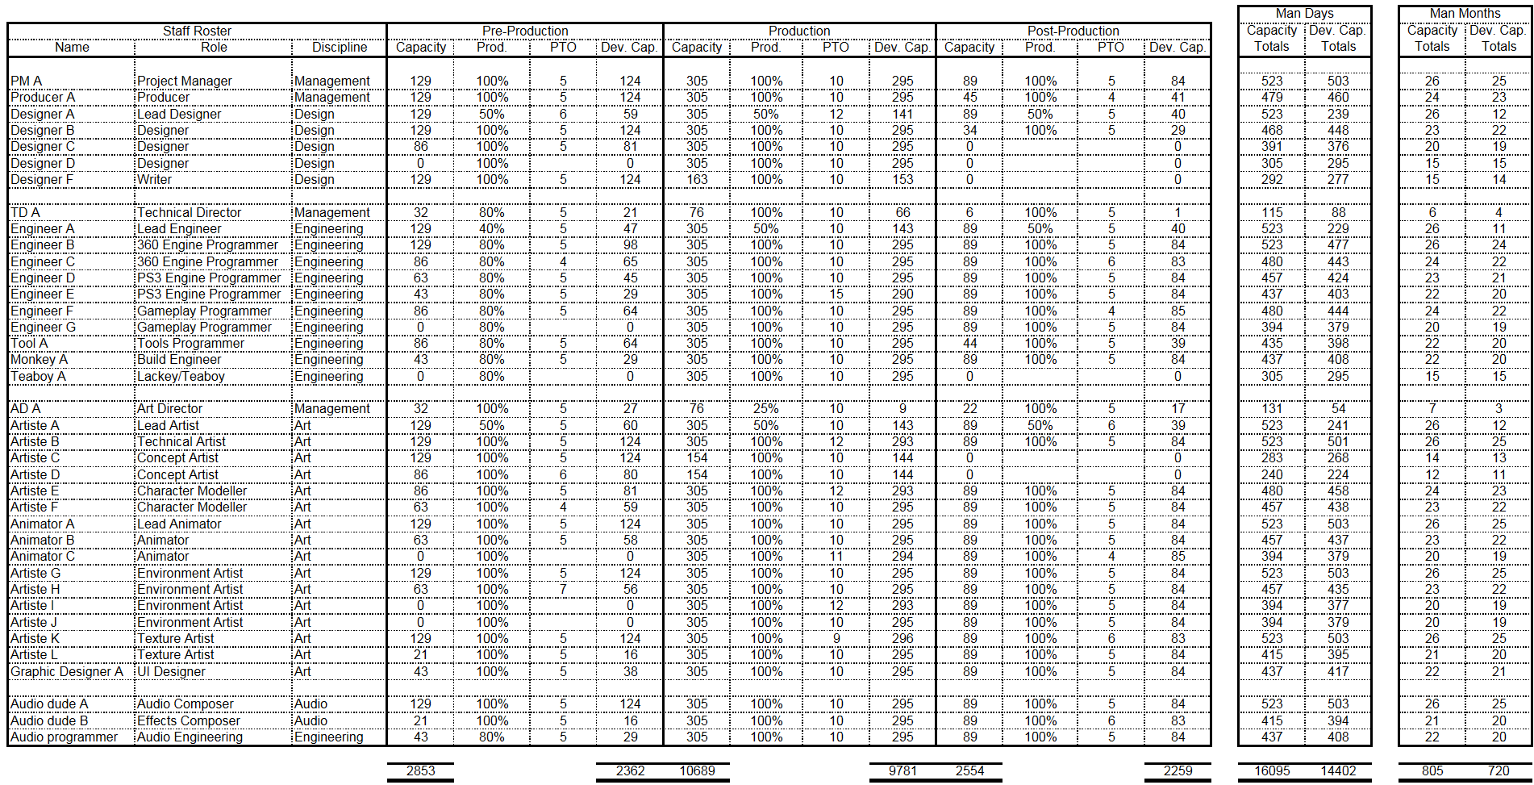
Development Capacity

Slide 12
Capacity Analysis
Capacity and Development Capacity are now understood in full.
Time spent by phase and discipline is known.
Cost of these capacities can now be calculated.
Development staff costs.
Phase cost.
Cost to get to Vertical Slice.
Cost of engineering.
Cost of engineers in pre-production.
etc…

Slide 13
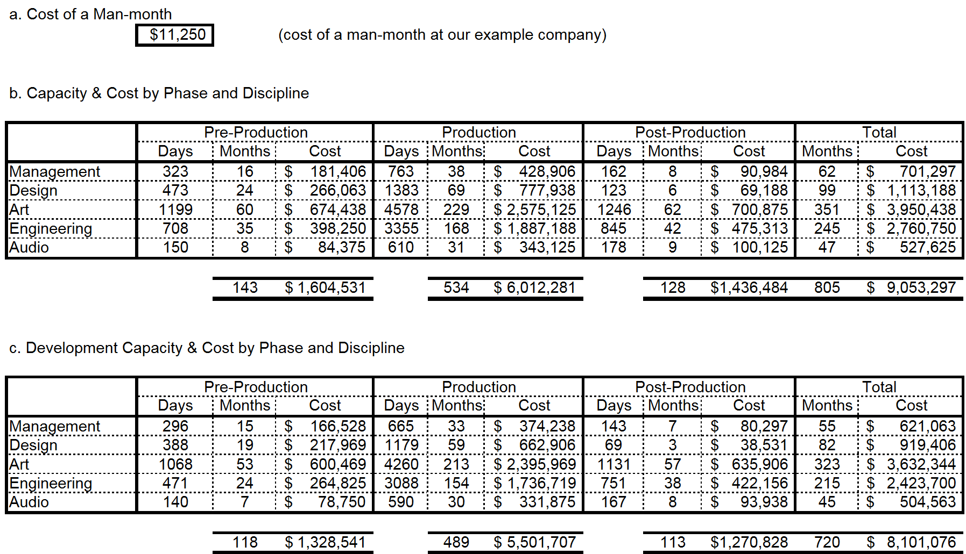
Capacity Analysis

Slide 14
Capacity Analysis
1st useful charting opportunities available.
Some are useful right now.
Some of them useful for collection and comparison with future projects.
Post-mortem.
Excellent for peer and executive review.

Slide 15
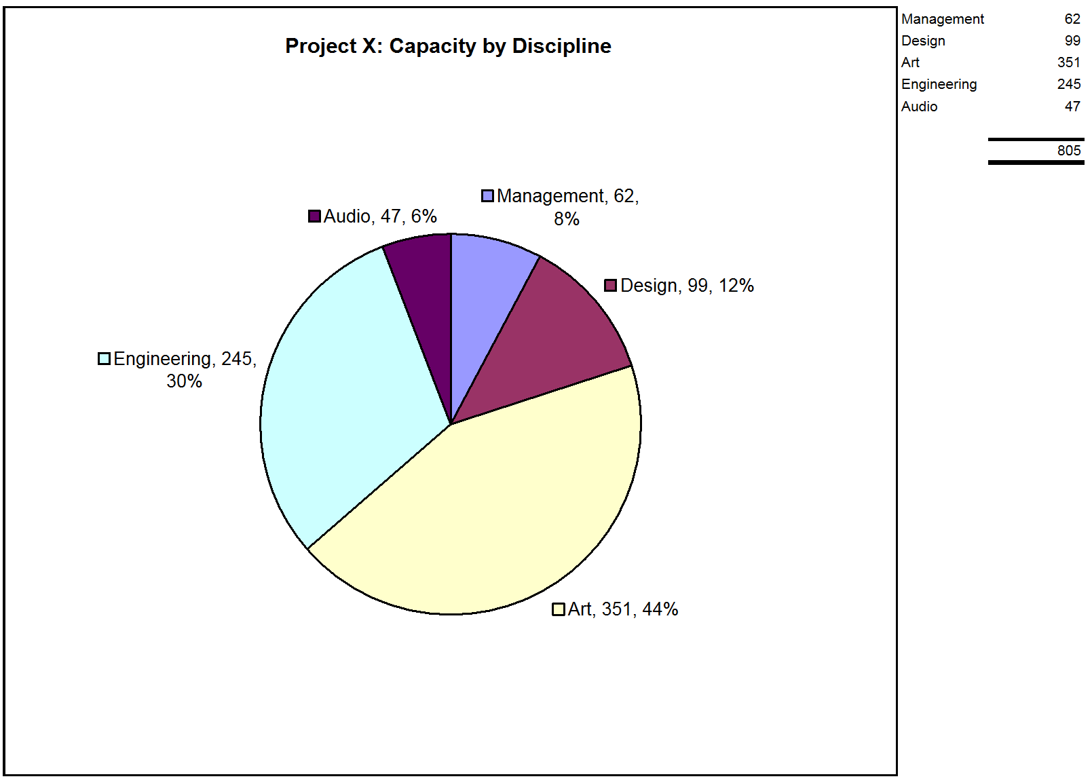

Slide 16
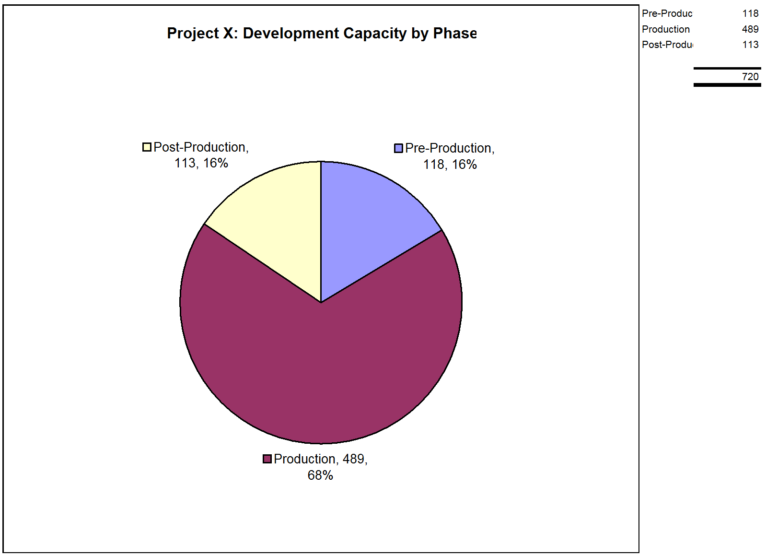

Slide 17
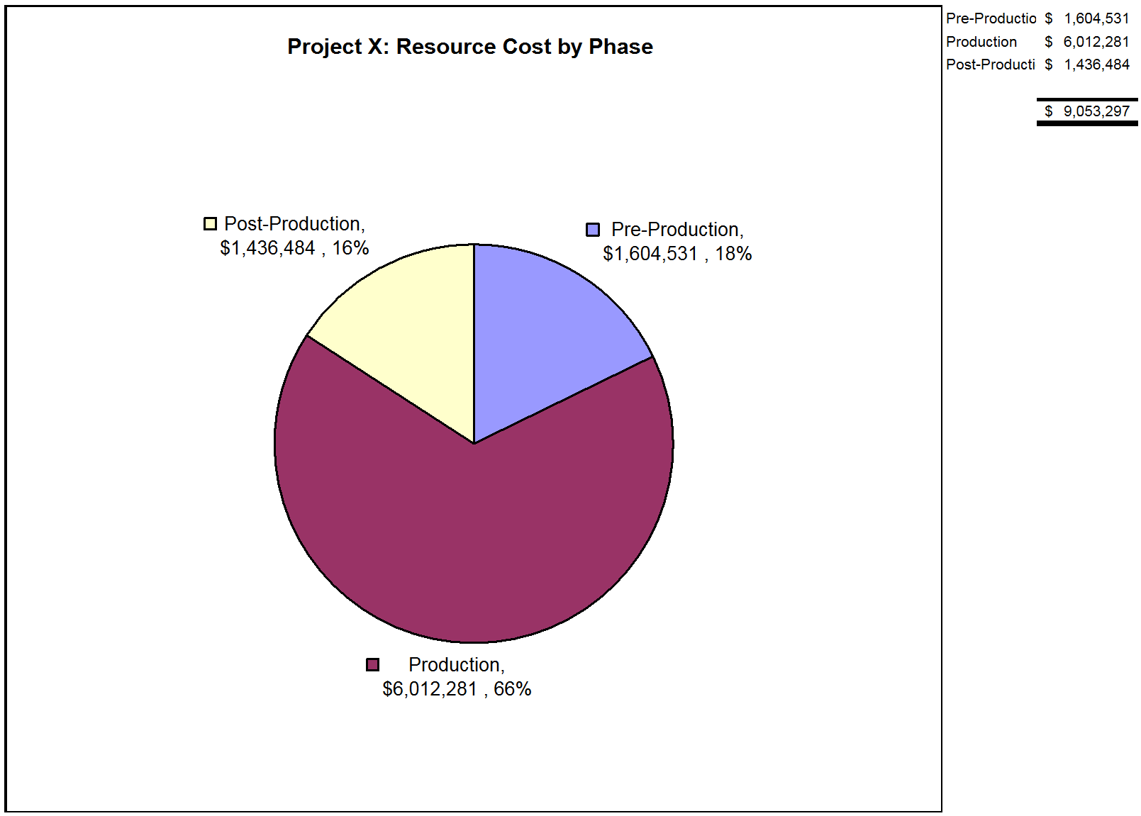

Slide 18
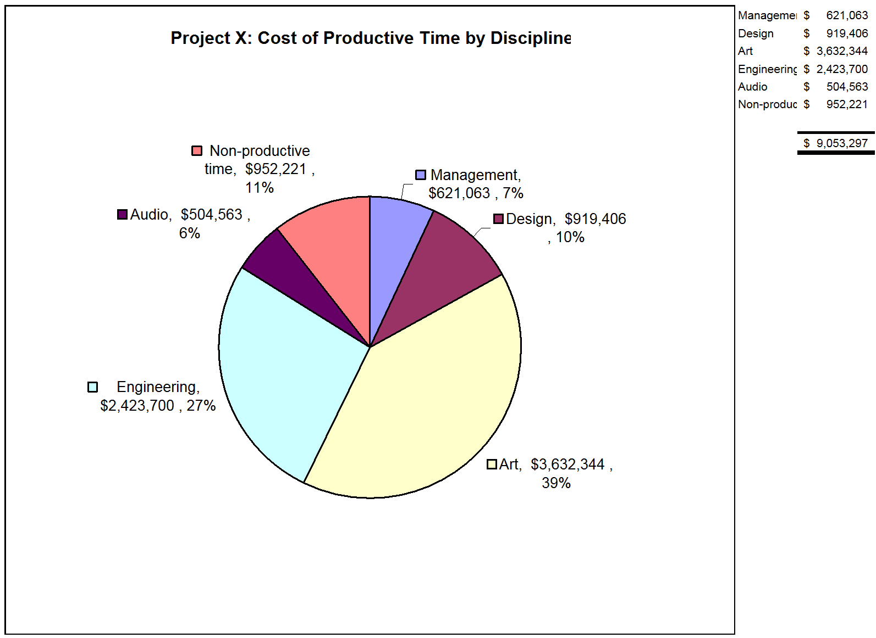

Slide 19
Reality Check
Yes, project is an example but it’s realistic.
It’s also a small team. Gulp.
Remember: 20% off engineers, not artists.
Large overhead of non-productive time. Ouch!
A decent proportion of the budget is spent on project management.

Slide 20
Project Managers beware!
A proportion of the budget doesn’t go to game features.
Publishers and Developers need to pay more attention to this!
Given the cost (or funding) of project management
Publishers should expect better planning.
Employers should expect more from planners.
Teams should be serviced by the best PM’s.
Is this a fair deal?

Slide 21
Capacity Analysis - done
Now complete.
Next…
Begin feature planning.
Ultimately move onto task planning.
Does your process support this?
Most (if not all) of this is pre-production.
Also requires team buy in.

Slide 22
Feature Planning #1
Opportunity to categorize work.
Assess it by risk and value.
1st opportunity to cut scope.
Don’t waste time and money on lofty goals.
But beware of cutting features prior to full assessment.
Based on
Game pillars.
Game features.
Risk vs value (of feature or pillar).

Slide 23
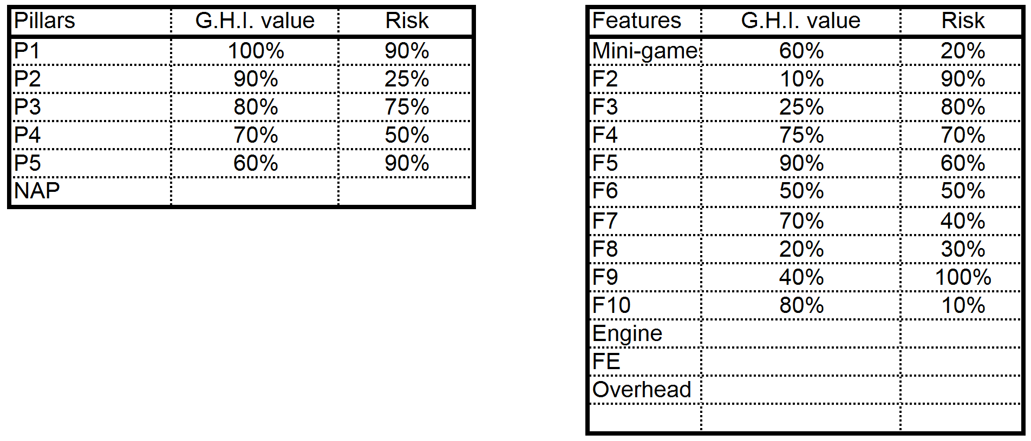
Feature Planning #1

Slide 24
Pillar Analysis (Value vs Risk)
No pillar should be low in value.
Avoid left side of chart.
Pillars will have risk.
Topmost pillars may need related work to be less risky.

Slide 25
Feature Analysis (Value vs Risk)

Slide 26
Engineering Worksheet
The place where tasks are entered.
Engineering in this case.
Task durations are summed for future comparison to capacity.
Tasks are budgeted to Pillar, Feature and Phase.
Quality of estimations are tracked.

Slide 27
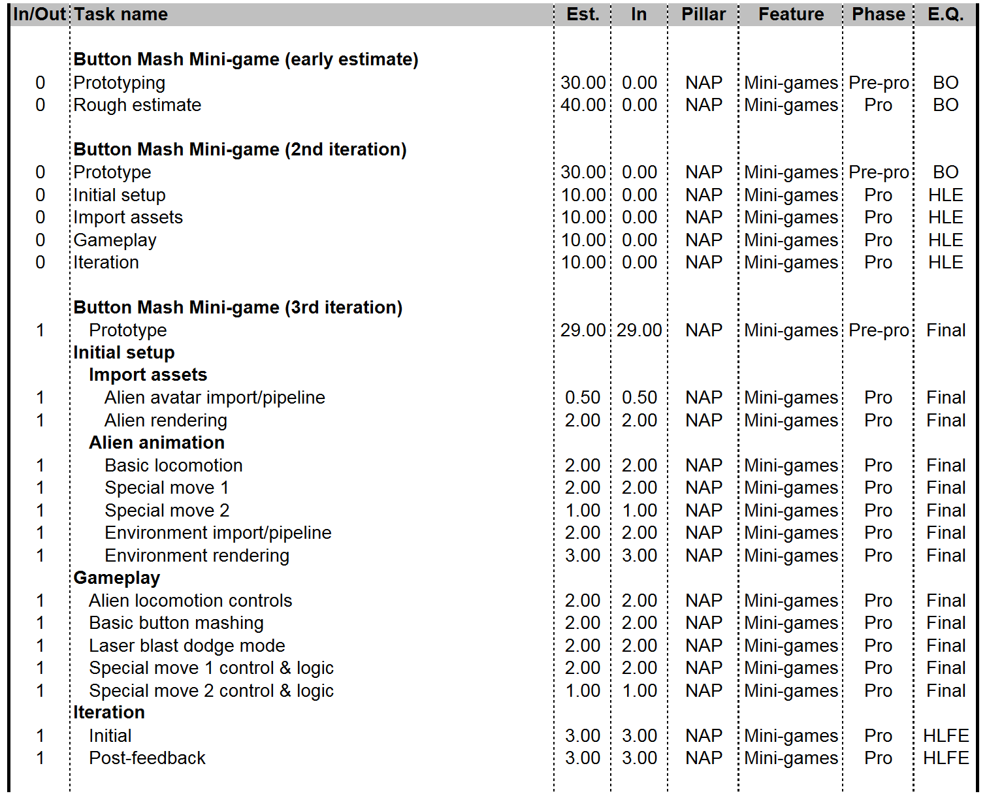
Engineering Worksheet

Slide 28
Worksheet Goals
By end of pre-production.
Complete
Largely based on quality estimates.
Transferable to schedule.
Complete is not necessarily final.
Include agreed iteration and contingencies.
My tip: Actually complete things at milestones.
What about Agile methodologies?

Slide 29
Task Lifecycle & Quality
Task entry begins early (ASAP)
Doesn’t matter if estimates begin as ‘high level’.
Pre-production goal is to iterate on detail of tasks.
Quality of estimations is progressive.
Track how well your tasks are estimated.
This can be used to drive pre-production planning.
Provide a snapshot of task list quality.
Should be very well estimate by end of pre-production.
See ‘Button Mash Mini-game’ example.

Slide 30
Estimation Quality

Slide 31
Worksheet Analysis
Already covered Estimation Quality.
Tasks are budgeted to Pillar, Feature and Phase.
Excellent opportunity for analysis through even more funky charts.
Great scope management tools.
Using these analysis opportunities are the key towards ‘Better than a Schedule’ planning.

Slide 32
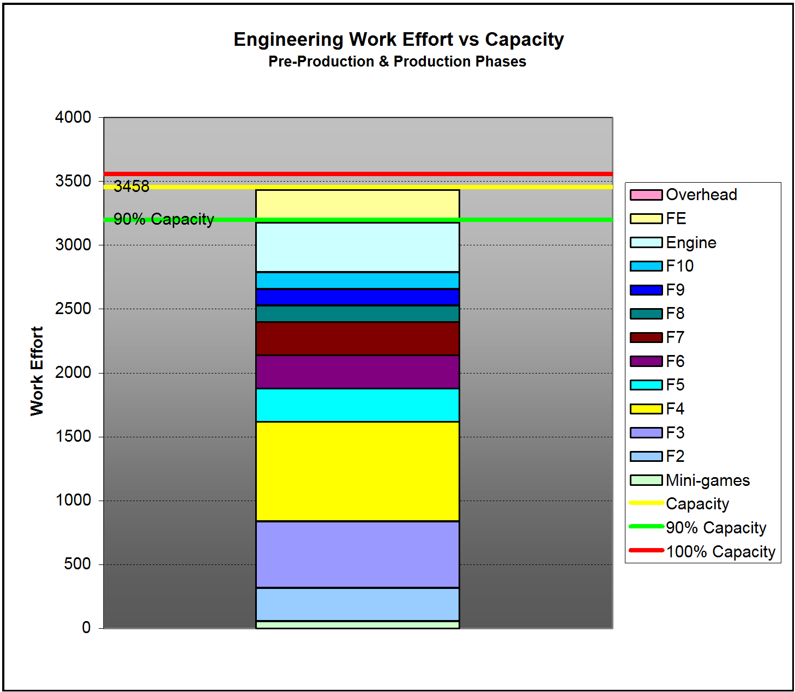
Engineering Analysis

Slide 33
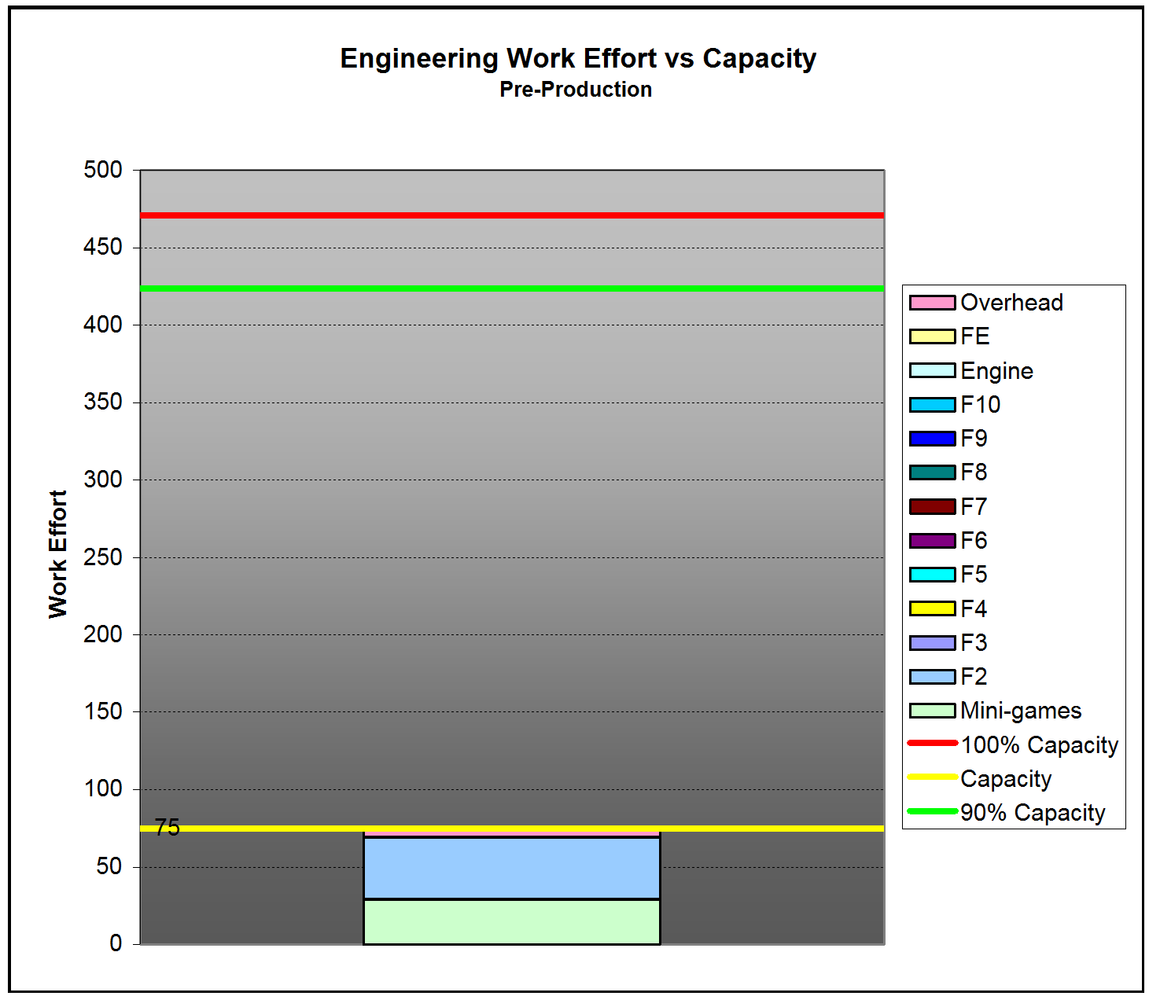
Engineering Analysis – Pre-pro

Slide 34
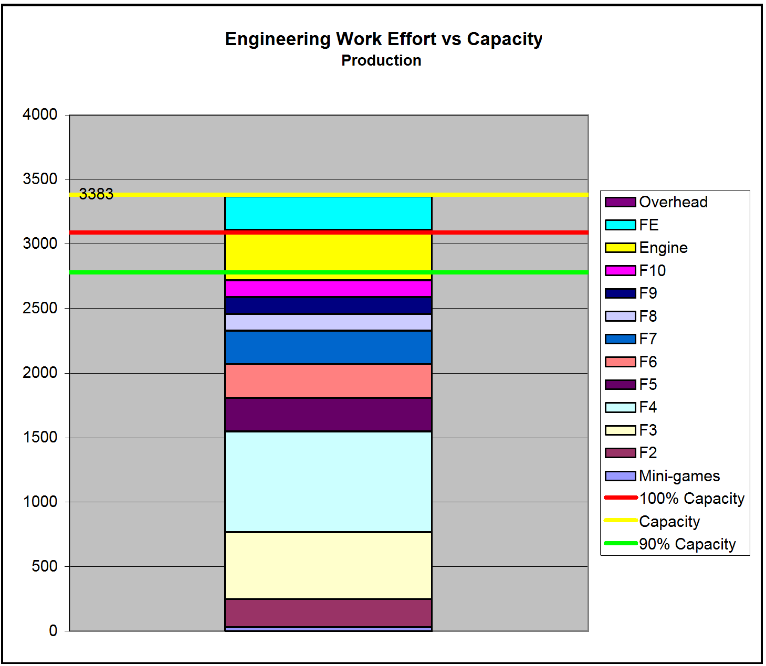
Engineering Analysis - Production

Slide 35
Feature Analysis #2

Slide 36
Feature Analysis #2

Slide 37
Other Charts
Art & Design.
Not presented to save time.
Similar to engineering.
No design for me though.
20% art contingency.
Remember tasking the engineers to 80%.
Alternative is to insert a 20% of capacity size task in worksheet.
Would see large chunk in art overhead on stacked chart.
You also need combined charts.
Need to look at Art + Engineering + Design too.

Slide 38
Scope Management
Use combinations of charts to review situation.
Constant and iterative process.
Use the worksheets and charts to scope tasks to the established development capacity.
Present your case to team and stakeholders.
Great tools for consensus on features by end of pre-production.
Project is in control from an early stage.
Features and schedule are under control.
Quality time is maximized.
Crunch is minimized.

Slide 39
Change Management
Tasks get progressively more detailed throughout pre-production anyway.
Reality: Features are sometimes added/changed beyond that.
Easy to digest new data.
Add new work with ease.
Switch tasks in/out.
Work with team and stakeholders.
Accommodate changes.
Suggest alternatives.
Easy consensus.

Slide 40
Better than a Schedule?
Planned, not just ‘tracked’.
Planned with diligence.
Detailed.
Meticulous.
Project Manager vision is established.

Slide 41
Wrap
Process is important too
Scope of discussion to small for me to present this.
More details?
Slides and bonus material @ www.jezsherlock.com
Questions?

